Slide 1
Introduction
Name: Vatsal Ramani
Enrollment No: 92110133020
Topic: Number of people count
Subject: Artificial Intelligence

Slide 2
Introduction: Number of people count
This is a Python script that uses the OpenCV library for detecting and counting the number of people in a video stream.
The script starts by importing the necessary libraries, including OpenCV. It then creates a Haar cascade classifier for detecting full body profiles of people using the 'haarcascade_fullbody.xml' file..

Slide 3
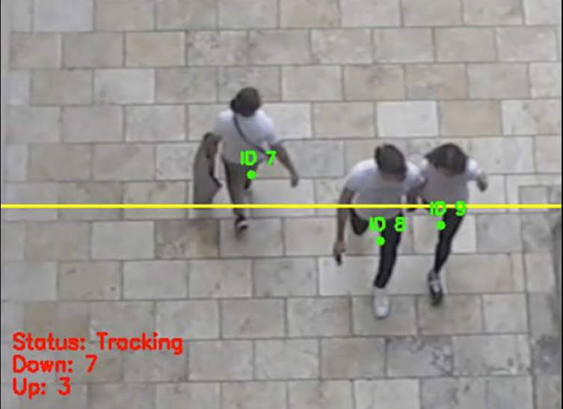
Objectives
The loop continues until the user presses the 'q' key, at which point the video capture object is released and all windows are closed.
We can give path and import the dataset. Then obtain classifier that is accurate. We use libraries or computations.
Then we detecting peoplein images.
Extracting each and individual people
When we apply object detection we are determining where in an image/frame an object is. An object detector is also typically more computationally expensive
The script then initializes a video capture object using the default camera, and enters a loop that captures frames from the camera and processes them.

Slide 4


Slide 5
Project Code
import cv2
person_cascade = cv2.CascadeClassifier(cv2.data.haarcascades + 'haarcascade_fullbody.xml')
people_count = 0
people_detected = []
min_person_size = 10000
max_person_distance = 100
cap = cv2.VideoCapture(0)
while True:
ret, frame = cap.read()
frame_gray = cv2.cvtColor(frame, cv2.COLOR_BGR2GRAY)
people = person_cascade.detectMultiScale(frame_gray, 1.1, 4)
for (x, y, w, h) in people:
if w * h > min_person_size:
person_detected = False
for (xp, yp) in people_detected:
if abs(x - xp) < max_person_distance and abs(y - yp) < max_person_distance:
person_detected = True
break
if not person_detected:
people_count += 1
people_detected.append((x, y))
for (x, y, w, h) in people:
cv2.rectangle(frame, (x, y), (x + w, y + h), (0, 255, 0), 2)
cv2.putText(frame, f"Unique people count: {len(people_detected)}", (10, 70), cv2.FONT_HERSHEY_SIMPLEX, 1, (0, 255, 0), 2)
cv2.imshow('People Counting', frame)
if cv2.waitKey(1) == ord('q'):
break
cap.release()
cv2.destroyAllWindows()

Slide 6
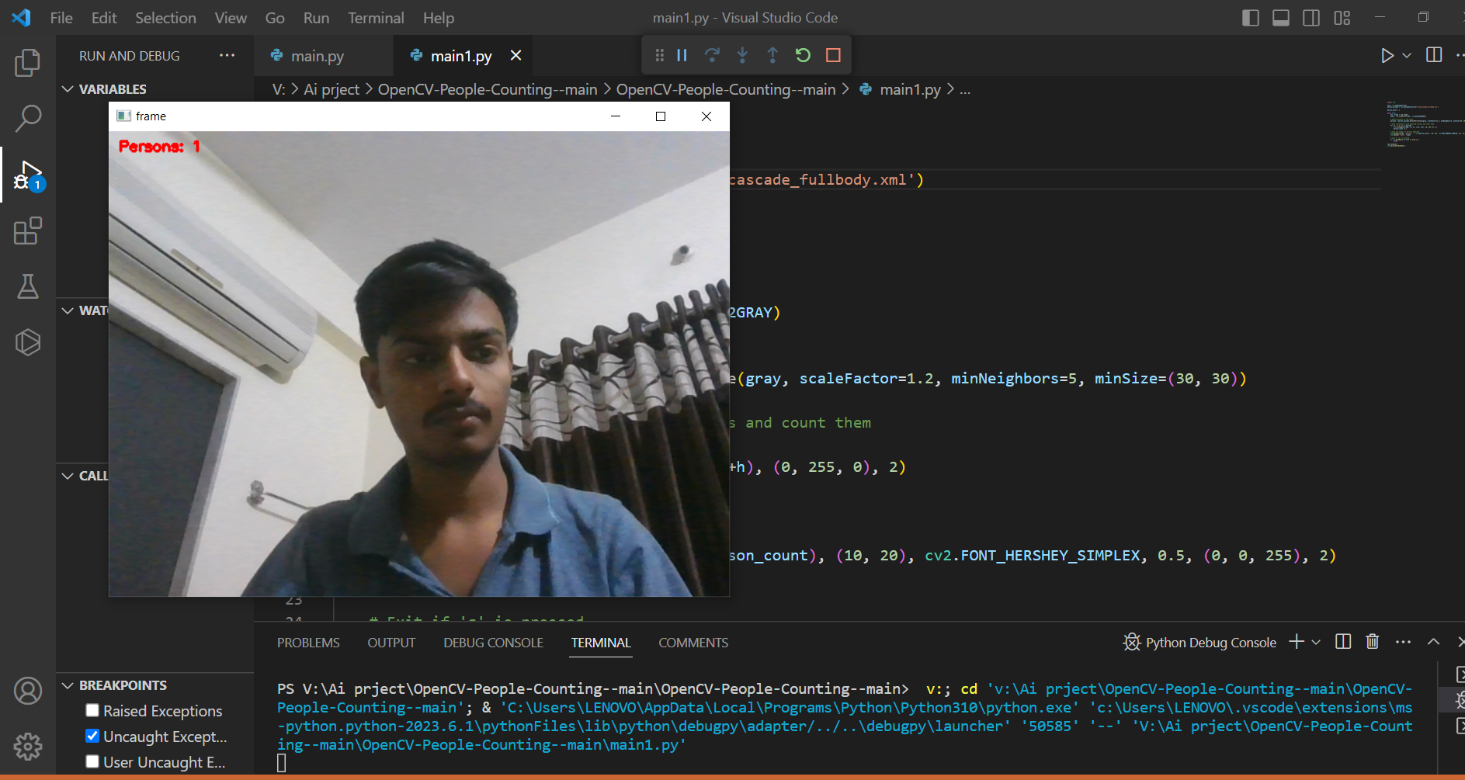
Live Example Number people count Image

Slide 7
Conclusion
In conclusion, counting the number of people using Python can be achieved using various techniques like Haar Cascade classifier, deep learning models, and background subtraction.
The accuracy of people counting can be improved by addressing the challenges like occlusion and lighting conditions. Finally, people counting has several applications in traffic analysis, crowd management, and security systems.

Slide 8

Output of code

Slide 9
Thank You
Guided By: Prof. Nishith Kotak

